Slide 1
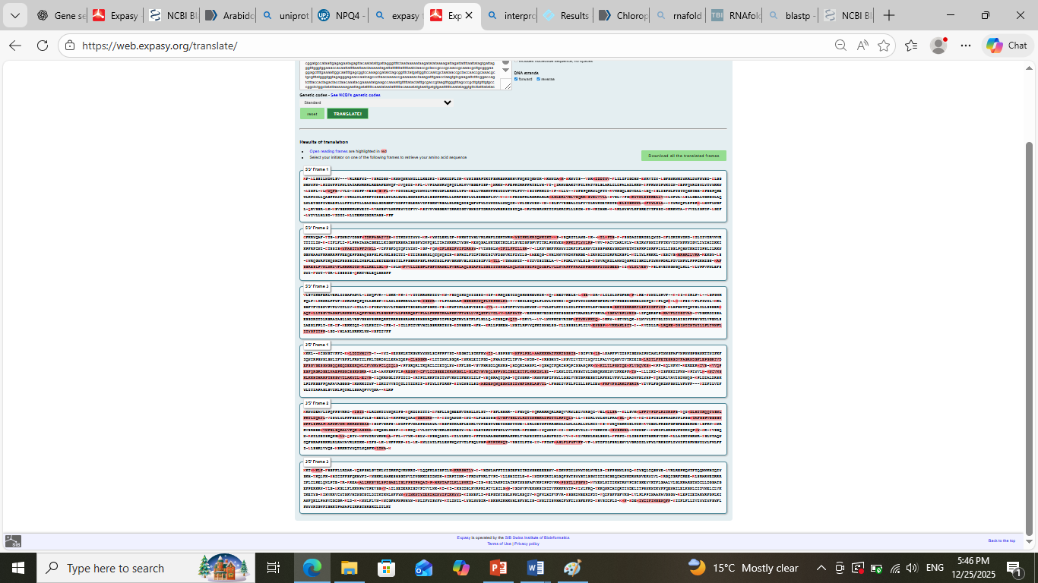
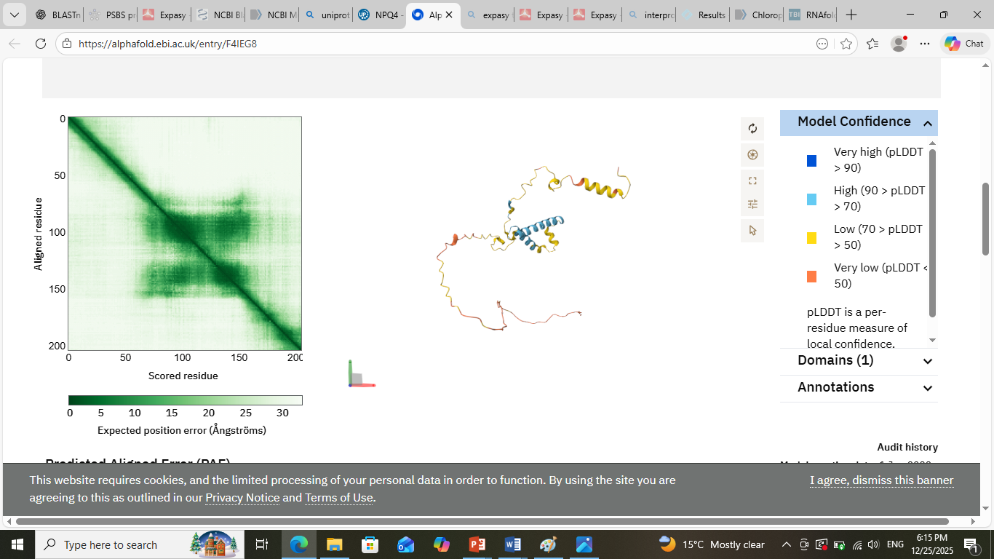
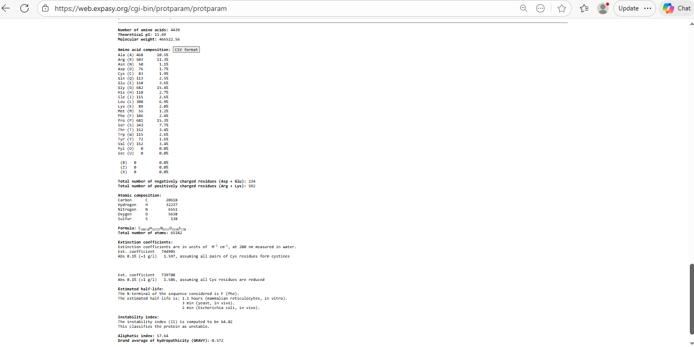
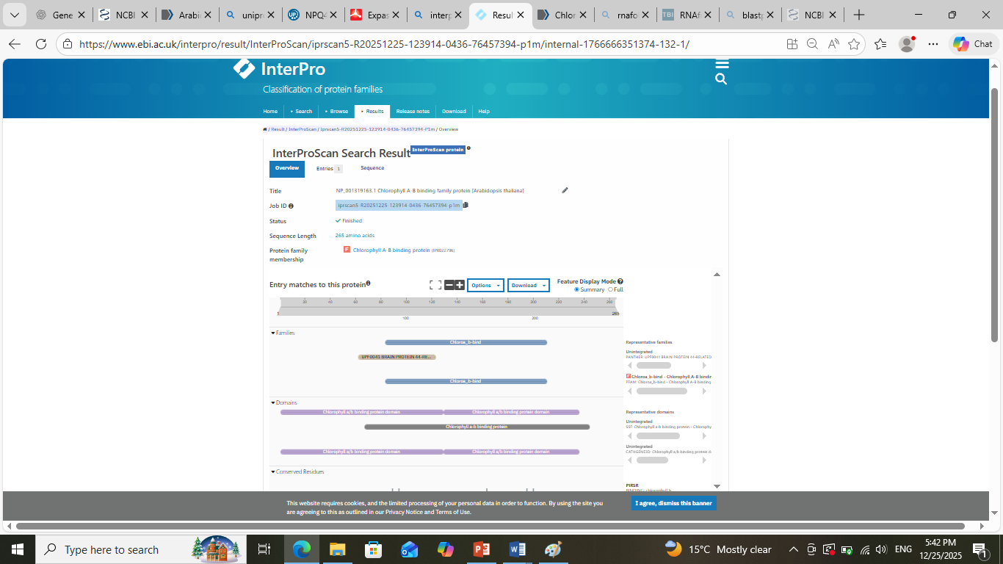


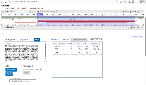
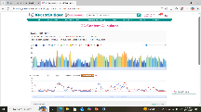
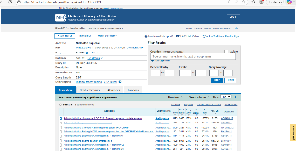



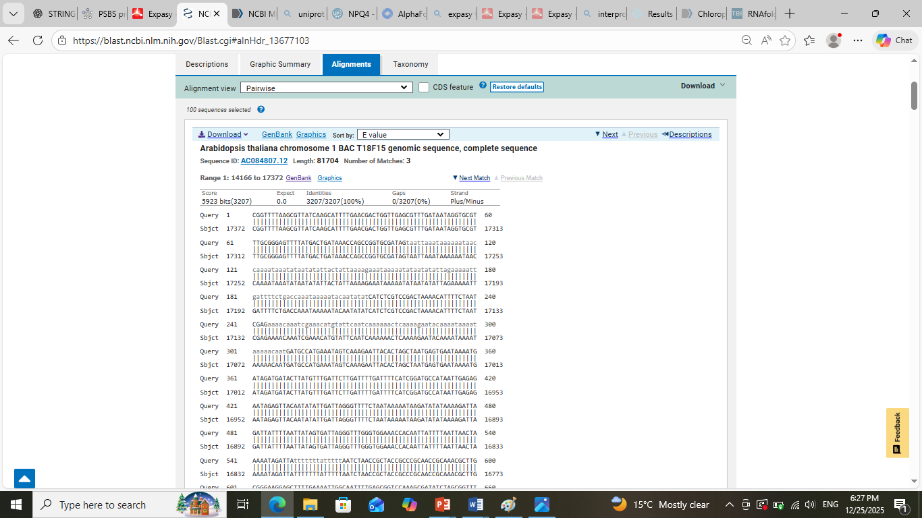

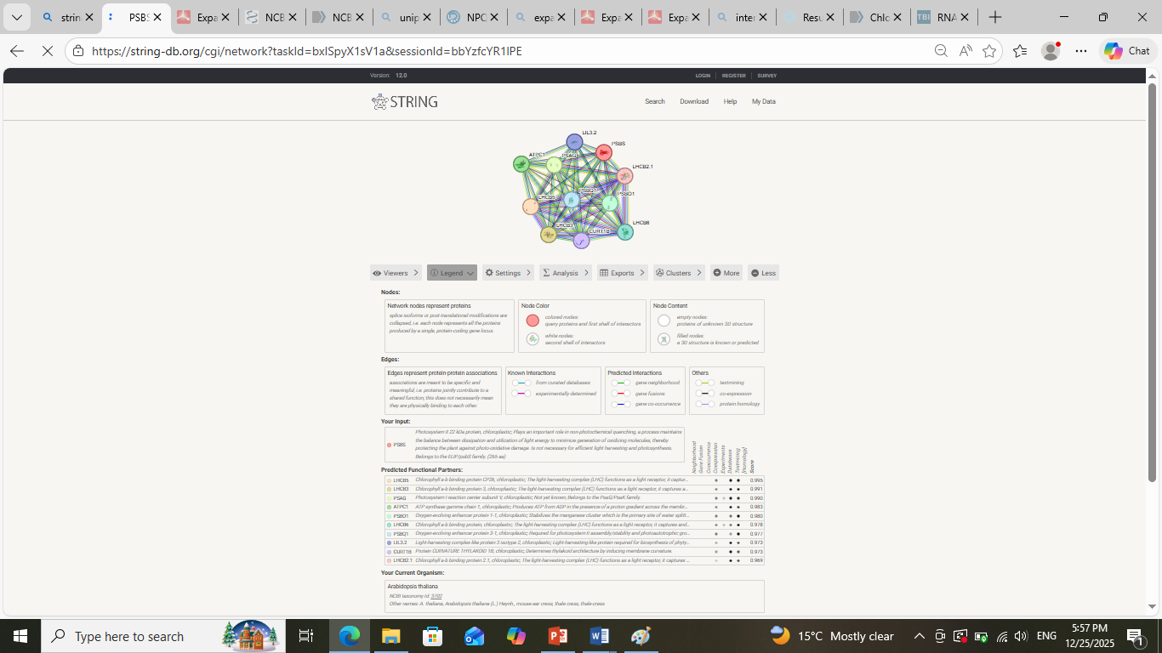
COMPUTATIONAL ANALYSIS OF ARABIDOPSIS THALIANA CHLOROPHYLL A-B BINDING FAMILY PROTEIN (NPQ4)
MALAIKA KIRAN I DEPARTMENT OF BIOCHEMISTRY I BIOINFORMATICS PROJECT
INTRODUCTION
PROTEIN ANALYSIS
Arabidopsis thaliana BAC clone T18F15 from chromosome 1 represents a key genomic region for in-silico analysis. This study integrates DNA analysis to identify nucleotide composition and ORFs, RNA analysis to examine transcriptional features, and protein analysis to predict structure and function. Phylogenetic analysis explores evolutionary relationships, while subcellular localization and protein–protein interaction studies reveal functional roles and potential molecular networks of the encoded proteins.
NPQ4 (PsbS) is predicted to function as a key regulator of non-photochemical quenching in Arabidopsis thaliana. It acts as a pH sensor in the thylakoid membrane, triggering the safe dissipation of excess absorbed light energy as heat under high-light conditions. This photoprotective role prevents oxidative damage and maintains photosystem II efficiency.
DNA ANALYSIS
SUBCELLULAR LOCALIZATION
BLASTn analysis showed a 100% identity and complete query coverage with Arabidopsis thaliana chromosome 1 BAC T18F15 genomic sequence (E-value = 0.0).
Additional high-scoring hits matched A. thaliana chromosome 1 assemblies and chlorophyll a–b binding family protein–related sequences.
These results confirm the genomic origin and functional relevance of the query sequence in Arabidopsis thaliana.
ORFfinder identified three open reading frames on both forward and reverse strands of the sequence.
ORF2 was selected as the final ORF because it is the longest (511 aa) and lacks premature stop codons.
The size and translation of ORF2 are consistent with a functional chlorophyll a–b binding family protein.
The NPQ4 protein (PsbS) is predicted to be localized in the chloroplast, specifically associated with the thylakoid membrane. Both TargetP and DeepLoc indicate high chloroplast localization due to the presence of a chloroplast transit peptide and membrane-associated helices. This prediction is consistent with experimental evidence showing NPQ4’s role in non-photochemical quenching within photosystem II. Therefore, the protein’s final predicted location is the chloroplast thylakoid membrane, where it regulates photoprotection.
RNA ANALYSIS
PHYLOGENETIC ANALYSIS
The RNAfold prediction shows a well-defined secondary structure with multiple stem–loop and branching regions, indicating extensive intramolecular base pairing. Stability of the structure is reflected by the presence of long stems with high base-pairing probabilities (green/blue regions), which contribute to a lower minimum free energy (MFE). The MFE structure represents the most thermodynamically stable conformation under physiological conditions, while unpaired or weakly paired regions (red/yellow) indicate flexible loops and bulges.
This phylogenetic analysis demonstrates that the PSBS (Photosystem II subunit S) gene is highly conserved among flowering plants, particularly within the Brassicaceae lineage. The close clustering of Arabidopsis PSBS with homologs from Brassica and Camelina species highlights the strong evolutionary conservation of photoprotective mechanisms, especially non-photochemical quenching (NPQ). Since NPQ is essential for protecting plants from excess light stress, conservation of PSBS suggests strong selective pressure to maintain its structure and function. The presence of homologs across diverse plant taxa indicates that PSBS originated early in plant evolution and has remained functionally indispensable for photosynthetic efficiency, stress tolerance, and survival under fluctuating light conditions.
PROTEIN-PROTEIN INTERACTION
CONCLUSIONS AND REFERENCES
Biologically, this interaction network highlights the coordinated regulation of light harvesting and photoprotection during photosynthesis. PSBS plays a crucial role in non-photochemical quenching (NPQ), a protective mechanism that safely dissipates excess absorbed light energy as heat, preventing photodamage under high-light conditions. Its strong interactions with LHCB proteins emphasize how PSBS functionally integrates with the light-harvesting antenna of PSII to balance energy capture and protection. The close connectivity among these proteins ensures efficient energy transfer under optimal conditions while enabling rapid protective responses during light stress. Overall, the STRING map underscores the functional interdependence of PSII antenna proteins that is essential for plant survival, photosynthetic efficiency, and adaptation to fluctuating light environments.
The computational analysis of NPQ4 (PSBS) highlights its central role in plant photoprotection and photosynthetic regulation. Sequence-based analyses confirm that NPQ4 is a highly conserved chloroplast-localized protein across plant species, particularly within the Brassicaceae family, indicating strong evolutionary pressure to maintain its function. Phylogenetic analysis places Arabidopsis thaliana NPQ4 in close relationship with homologs from related species, supporting a shared evolutionary origin and functional conservation.
Protein–protein interaction analysis using STRING reveals that NPQ4 is tightly integrated within the photosystem II light-harvesting complex, showing strong associations with LHCB proteins involved in light capture and energy transfer. These interactions underline NPQ4’s critical role in non-photochemical quenching (NPQ), where it facilitates the safe dissipation of excess excitation energy as heat, thereby preventing photoinhibition and oxidative damage under high-light stress.
Overall, this computational study demonstrates that NPQ4 is a key regulatory component of photosystem II, essential for maintaining photosynthetic efficiency and plant stress tolerance. Such in silico analyses provide valuable insights into gene function, evolutionary conservation, and interaction networks, forming a strong foundation for future experimental validation and functional studies.
References
Li, X.-P., Björkman, O., Shih, C., Grossman, A. R., Rosenquist, M., Jansson, S., & Niyogi, K. K. (2000).
A pigment-binding protein essential for regulation of photosynthetic light harvesting.
Nature, 403(6768), 391–395. https://doi.org/10.1038/35000131
Niyogi, K. K., Truong, T. B. (2013).
Evolution of flexible non-photochemical quenching mechanisms that regulate light harvesting in oxygenic photosynthesis.
Current Opinion in Plant Biology, 16(3), 307–314. https://doi.org/10.1016/j.pbi.2013.03.011
Ashburner, M., et al. (2000).
Gene Ontology: tool for the unification of biology.
Nature Genetics, 25(1), 25–29. https://doi.org/10.1038/75556
Szklarczyk, D., et al. (2021).
The STRING database in 2021: customizable protein–protein networks, and functional characterization of user-uploaded gene/measurement sets.
Nucleic Acids Research, 49(D1), D605–D612. https://doi.org/10.1093/nar/gkaa1074
Altschul, S. F., Gish, W., Miller, W., Myers, E. W., & Lipman, D. J. (1990).
Basic local alignment search tool.
Journal of Molecular Biology, 215(3), 403–410. https://doi.org/10.1016/S0022-2836(05)80360-2
Kumar, S., Stecher, G., Li, M., Knyaz, C., & Tamura, K. (2018).
MEGA X: Molecular Evolutionary Genetics Analysis across computing platforms.
Molecular Biology and Evolution, 35(6), 1547–1549. https://doi.org/10.1093/molbev/msy096

